Slide 1
Need for Virtualization

Slide 2
Need for Virtualization
virtualization plays a crucial role in modern computing environments by providing efficiency, flexibility, scalability, security, and cost savings across various use cases and industries.
Major needs of virtualization are:
Resource Utilization
Flexibility and Scalability
Disaster Recovery and Business Continuity
Enhanced Performance
Limited use of Resources
Shortage of Space
Eco-friendly initiatives
Administrative costs
Desktop Virtualization
Energy Efficiency

Slide 3
Need for Virtualization
Resource Utilization: Virtualization allows for better utilization of physical resources by running multiple virtual machines (VMs) on a single physical server.
This consolidation leads to improved efficiency and cost savings by maximizing the use of hardware resources.
Flexibility and Scalability: Virtualization enables IT infrastructures to be more flexible and scalable.
Virtual machines can be easily provisioned, migrated, and scaled up or down based on demand, allowing organizations to adapt quickly to changing business needs.
Disaster Recovery and Business Continuity: Virtualization facilitates the creation of snapshots and backups of entire virtual machines, making disaster recovery and business continuity planning more efficient.

Slide 4
Energy Efficiency:
By consolidating multiple virtual machines onto fewer physical servers, virtualization can lead to significant energy savings in data centers, reducing both electricity consumption and cooling costs.

Slide 5
Enhanced Performance:
PC is sufficiently powerful to fulfill all the basic computation requirements of the user, with various additional capabilities which are rarely used by the user.
Most of their systems have sufficient resources which can host a virtual machine manager and can perform a virtual machine with acceptable performance
Limited use of Resources:
The limited use of the resources leads to under-utilization of hardware and software resources.
As all the PCs of the user are sufficiently capable to fulfill their regular computational needs that’s why many of their computers are used often which can be used 24/7 continuously without any interruption.
The efficiency of IT infrastructure could be increase by using these resources after hours for other purposes. This environment is possible to attain with the help of Virtualization.

Slide 6
Shortage of Space:
The regular requirement for additional capacity, whether memory storage or compute power, leads data centers raise rapidly.
Companies like Google, Microsoft and Amazon develop their infrastructure by building data centers as per their needs.
Mostly, enterprises unable to pay to build any other data center to accommodate additional resource capacity.
Eco-friendly initiatives:
Corporations are actively seeking for various methods to minimize their expenditures on power which is consumed by their systems.
Data centers are main power consumers and maintaining a data center operations needs a continuous power supply.
server consolidation drops the power consumed and cooling impact by having a fall in number of servers.
Virtualization can provide a sophisticated method of server consolidation.

Slide 7
Administrative costs:
The rise in demand for capacity surplus, that convert into more servers in a data center, accountable for a significant increase in administrative costs.
Hardware monitoring, server setup and updates, defective hardware replacement, server resources monitoring, and backups are included in common system administration tasks.
These are personnel-intensive operations. The administrative costs is increased as per the number of servers.
Virtualization decreases number of required servers for a given workload, hence reduces the cost of administrative employees.

Slide 8
Desktop Virtualization:
Virtualization extends beyond servers to desktop environments, enabling centralized management of desktops and applications.
Desktop virtualization solutions offer benefits such as improved security, easier software deployment, and support for remote work
Energy Efficiency:
By consolidating multiple virtual machines onto fewer physical servers, virtualization can lead to significant energy savings in data centers, reducing both electricity consumption and cooling costs.

Slide 9
Advantage of Virtualization
Resource Utilization
Flexibility and Scalability
Disaster Recovery and Business Continuity
Enhanced Performance
Limited use of Resources
Shortage of Space
Eco-friendly initiatives
Administrative costs
Desktop Virtualization
Energy Efficiency

Slide 10
Disadvantage of Virtualization
Resource Overhead: Virtualization introduces some overhead in terms of CPU, memory, and storage resources due to the virtualization layer and additional management overhead.
Complexity: Managing virtualized environments can be complex, requiring specialized skills and tools for deployment, configuration, monitoring, and troubleshooting.
Single Point of Failure: While virtualization can improve fault tolerance and resilience, if the host server fails, it can impact multiple virtual machines, potentially causing a significant outage.
Licensing Costs: Some software vendors may require separate licenses for each virtual instance, which can increase licensing costs in virtualized environments.

Slide 11
Performance Degradation: In some cases, virtualization can lead to performance degradation compared to running applications on bare-metal servers, especially for high-performance computing workloads.
Compatibility Issues: Virtualization may encounter compatibility issues with certain hardware or software components, requiring additional effort to ensure compatibility and stability.
Security Concerns: While virtualization enhances security through isolation, it also introduces new attack vectors and security risks, such as VM escape attacks or vulnerabilities in the hypervisor software.
Vendor Lock-In:Adopting virtualization technologies from a specific vendor may lead to vendor lock-in, limiting flexibility and interoperability with other platforms or technologies.

Slide 12
Types of Virtualization
Application Virtualization
Network Virtualization
Desktop Virtualization
Storage Virtualization
Server Virtualization
Data virtualization

Slide 13
Application Virtualization
Application virtualization refers to the process of deploying a computer application over a network.
The deployed application is installed locally on a server, and when a user requests it, an instance of the application is displayed to them.
The user can then engage with that application as if it was installed on their system.
Application virtualization is a powerful concept that takes away most of the drawbacks of installing applications locally.
Users can also run applications not supported by their devices’ operating systems.

Slide 14
To achieve application virtualization, follow these practices:
Application streaming – Users stream the application from a remote server, so it runs only on the end user's device when needed.
Server-based application virtualization – Users can access the remote application from their browser or client interface without installing it.
Local application virtualization – The application code is shipped with its own environment to run on all operating systems without changes.
There are two types of application virtualization
Hosted applications
Packaged applications

Slide 15
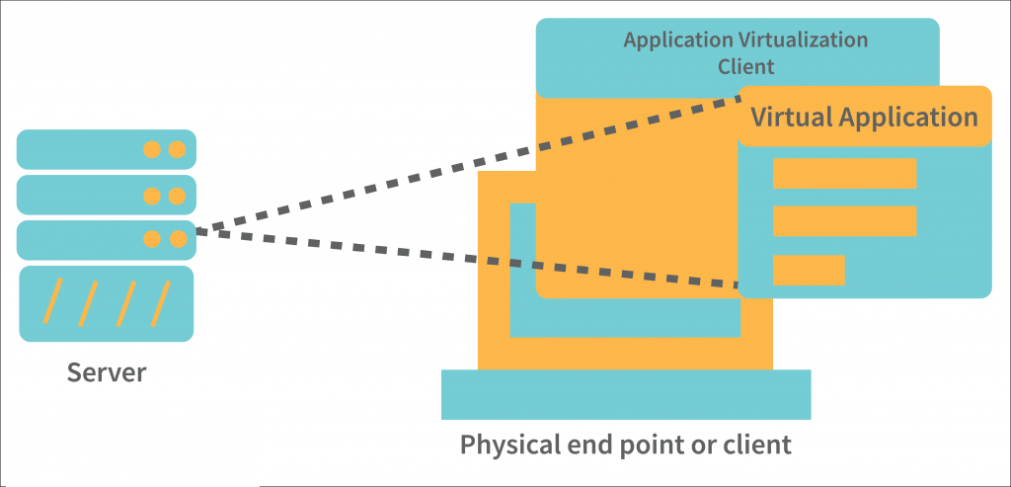
Application Virtualization

Slide 16
Network Virtualization
Network virtualization refers to combining all the components of networks and administering them using only software.
Network Virtualization refers to the virtualization of a network into a sub network that one could produce on the very same physical network.
It basically refers to a system where one can run multiple virtual networks at the same time and each of these networks have a separate control system and data plan.
It restricts the movement of files across multiple networks to make sure of the same.
It also helps you keep a better track of things on the network and allow for good supervision as well as identification of the data usage.
It is also a reliable and safe system as issues on one network do not have a domino effect on the other networks.
The main aimed result of Network Virtualization is to improve the efficiency and productivity of the network.

Slide 17
There are two types of Network Virtualizations in cloud computing:
Internal Network Virtualization : extends network-like functionality to a single system.
External Network Virtualization : Combines multiple networks or its individual parts into a single virtual unit.

Slide 18
Desktop Virtualization
The desktop environments, also called virtual machines (VMs), are housed on powerful servers that can host several desktop sessions concurrently.
Desktop virtualization is especially useful for enterprises as it offers a consistent desktop experience to all employees.
IT teams responsible for managing a company’s devices can now manage and issue updates centrally.
Virtual desktops also minimize the security risks associated with employees storing the company data locally.
And, since most of the data is stored on servers, device failure will not result in any major loss.
The following are types of desktop virtualization.
Virtual desktop infrastructure
Local desktop virtualization

Slide 19
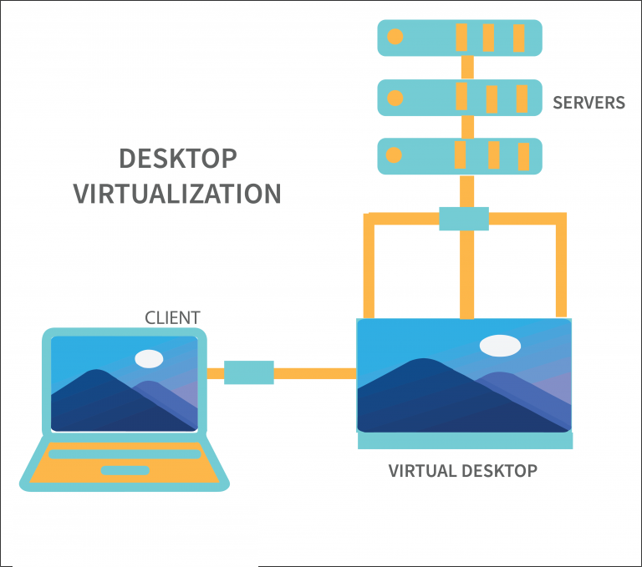

Slide 20
Storage Virtualization
Storage virtualization combines the functions of physical storage devices such as network attached storage (NAS) and storage area network (SAN).
Storage virtualization uses all your physical data storage and creates a large unit of virtual storage that you can assign and control by using management software.
IT administrators can streamline storage activities, such as archiving, backup, and recovery, because they can combine multiple network storage devices virtually into a single storage device.

Slide 21
The benefits of storage virtualization:
It allows for centralized management of all the storage devices by masking their individual hardware/software configurations.
It enables users to scale their storage capacity on-demand.
It allows organizations to manage large amounts of crucial data by allocating it to a single location.
Backing up, recycling and dropping data is much easier when consolidated at a single storage location.
Virtualizing storage offers better storage performance at significantly lesser expenses.
Automated management is another remarkable feature of storage virtualization.

Slide 22
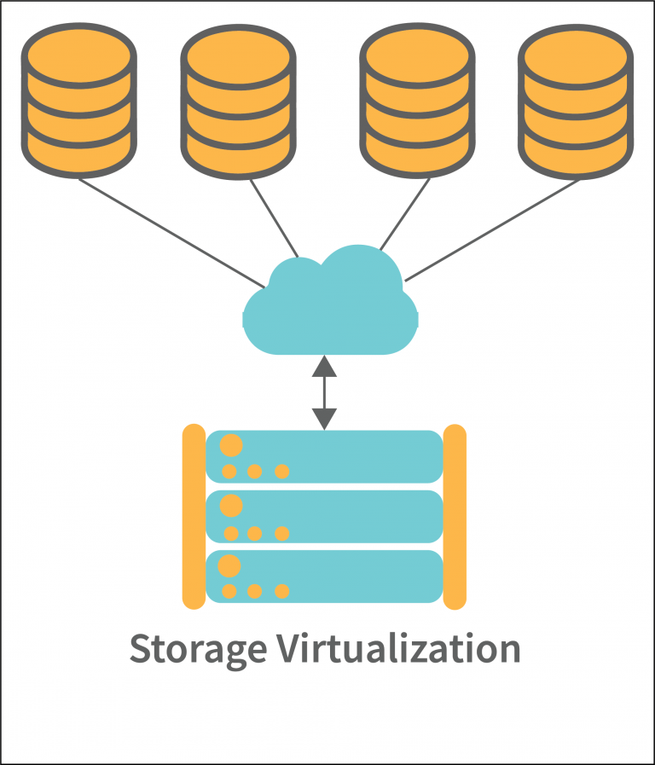

Slide 23
Server Virtualization
Server virtualization refers to partitioning the resources of a server, which consist of hardware, software and networking resources, and distributing them over a network.
The partitions are instances of a powerful physical server lying in a remote location but acting like standalone servers. These partitions are also called virtual servers.
Server virtualization allows for flexible scalability as, depending upon their need, users can request variable configurations of storage, computing power, RAM, etc from the physical server.
The process of virtualizing a server begins with installing hypervisors on it.
Hypervisors are pieces of software, aptly referred to as primal operating systems, that enable communication between the server and the installed programmes

Slide 24
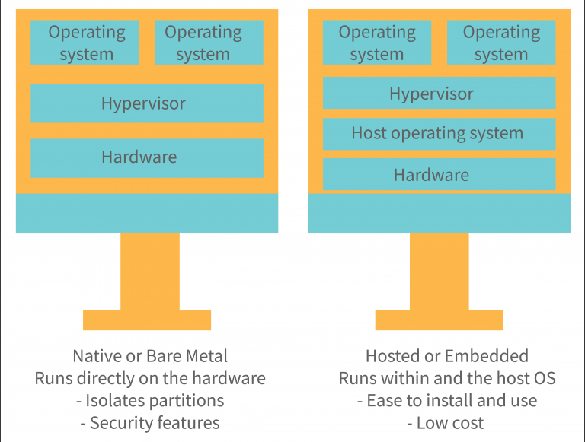

Slide 25
Data virtualization
Data Virtualization creates a separate virtual database. It allows for the manipulation of data and access to its physical location as well as an understanding of how it is formatted.
Data virtualization is a solution to the data management problem of analyzing data from different sources collectively and at a much faster pace.
It enables organizations to centrally manage and alter data from several sources, such as excel files, Google analytics reports, HubSpot reports.
Virtualizing data enables users to collectively view heterogeneous data sets via a single interface as well as access the source of the collected data in real-time.
Data virtualization is primarily used as a part of data integration in areas such as BI (business intelligence), Cloud computing and of course, data management.

Slide 26
Memory Virtualization
Memory Virtualization can be understood as a concept where multiple physical memories across different servers are put together as one to form a singular virtual memory. This allows you an access to a bigger memory to work on.
The main aim of this kind of virtualization is to provide for a better and a much more enhanced memory to function on.
There are two types of Memory Virtualizations-
Application-Level Control – In this system, the applications that run on the connected devices connect directly to the combined memory with the help of the file system or an API system.
Operating System Level Control – In this system, it is the operating system that first connects to the memory pool, making it available to the applications in the process.

Slide 27
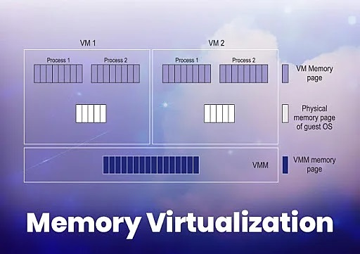
Memory Virtualization

